Slide 1
Intro to Technical Financial Evaluation with R

Slide 2






About me & This Workshop

Slide 3
Agenda
Start | End | Item
 |  | Securities Summary
 |  | Securities Technical Trading Indicator- SMA
 |  | Securities Technical Trading Indicator- MACD
 |  | Securities Technical Trading Indicator- RSI
 |  | Financial Risk Modeling
 |  | Non-Traditional Markets

Slide 4
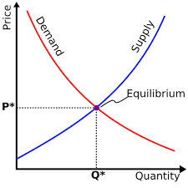
What is a Market?
Traditional Markets
Stock Markets
Bond Markets
Housing/Mortgages
Commodities – gold/silver etc
Crop Futures – corn/soybean
Consumer Credit
…
A market is one of the many varieties of systems, institutions, procedures, social relations and infrastructures whereby parties engage in exchange. Traditional markets are often regulated, have defined trading norms/rules, and have been in existence for some time.

Slide 5

Securities Trading can be distilled into 4 categories
Belief Based Investing
The intrinsic value of a company is appealing regardless of market and financial factors. As a result, intrinsic value changes trigger buy/sell action.
I like Wonder bread, so I bought stock in Flower Foods (FLO) since they make it.
https://www.steadygo.digital/blog/terrible-stock-photos/
Notes:
I like Netflix movies so I bought Netflix.
I don’t agree with tobacco sales so I avoid those stocks.
Warren Buffet “Buy companies you understand”

Slide 6

Securities Trading can be distilled into 4 categories
Fundamental Investing
Traditional financial performance indicators trigger an action regardless of sector, or company product.
Monsanto (MON) makes genetically modified food, I don’t care if they are safe. I bought the stock because the EPS is good.
Notes:
Reviewing an annual report and pouring over cash flow, revenue growth, expenditures like R/D all count as fundamental investing

Slide 7

Securities Trading can be distilled into 4 categories
Technical Trading Investing
Trade based on “indications”. Uses non-financial mathematical indicators to quantify risk/reward, or trigger buy/sell
Momentum – Recognize prices moving up/down at thresholds to trigger action
“Charting” – Chart patterns trigger actions (crossovers, head & shoulders)
The MACD crossover pattern for Smith & Wesson (AOBC) is positive so now is a good time to buy.
Notes:
Reviewing an annual report and pouring over cash flow, revenue growth, expenditures like R/D all count as fundamental investing

Slide 8
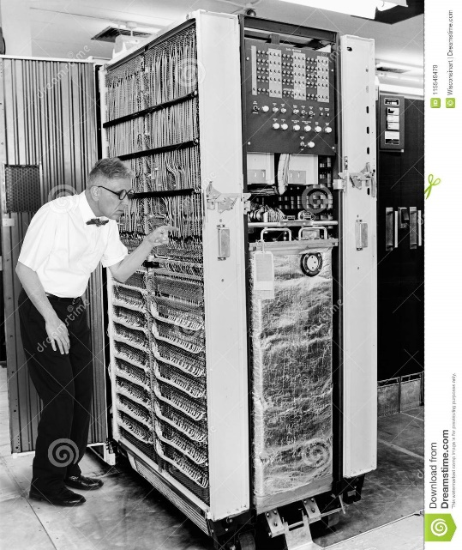

Securities Trading can be distilled into 4 categories
High Frequency Trading
Extremely technical trading executed without a human that can trigger thousands of actions measured in nano-seconds. “scalping” small profits thousands of times per minute.
1001100100…
Notes:
$460M

Slide 9
What type?
Belief Based – some intrinsic value of the company is appealing and triggers a buy/selling action.
Fundamental Trading - traditional financial indicator triggers an action regardless of sector, or company product.
Technical Trading – trade based on “indications”
High Frequency Trading – “scalping” small profits repeatedly
The Stochastic Momentum Indicator (SMI), a formula for measuring momentum, crossed over to positive territory. I think I will buy Google (Alphabet).

Slide 10
What type?
Belief Based – some intrinsic value of the company is appealing and triggers a buy/selling action.
Fundamental Trading - traditional financial indicator triggers an action regardless of sector, or company product.
Technical Trading – trade based on “indications”
High Frequency Trading – “scalping” small profits repeatedly
Our PhD physicist wrote an algorithm that trades apple stock 10,000 per minute.

Slide 11
What type?
Belief Based – some intrinsic value of the company is appealing and triggers a buy/selling action.
Fundamental Trading - traditional financial indicator triggers an action regardless of sector, or company product.
Technical Trading – trade based on “indications”
High Frequency Trading – “scalping” small profits repeatedly
I won’t buy firearm companies.

Slide 12
What type?
Belief Based – some intrinsic value of the company is appealing and triggers a buy/selling action.
Fundamental Trading - traditional financial indicator triggers an action regardless of sector, or company product.
Technical Trading – trade based on “indications”
High Frequency Trading – “scalping” small profits repeatedly
At ODSC we modeled the probability of risk using a decision tree and it looks like a buying a retail loan is a good investment.

Slide 13
What type?
Belief Based – some intrinsic value of the company is appealing and triggers a buy/selling action.
Fundamental Trading - traditional financial indicator triggers an action regardless of sector, or company product.
Technical Trading – trade based on “indications”
High Frequency Trading – “scalping” small profits repeatedly
Google’s quarterly ad revenue is improving, so I am going to buy some shares.

Slide 14
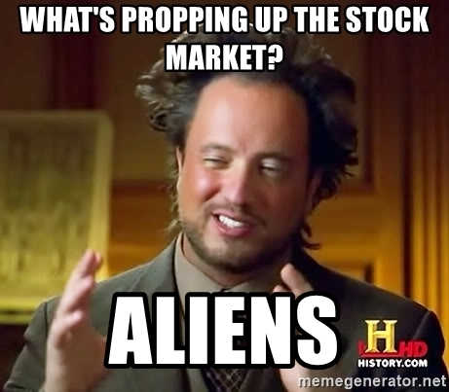
Financial Risk Modeling

Slide 15
Let’s zoom into Technical Trading Rules (TTR)
Our learning goal is to use and understand some of the common technical indicators which affect you as a saver, pension holder, stock trader etc.
Our learning goal is NOT to make you a trader, or convince you that you are now qualified to be a technical trader.

Slide 16
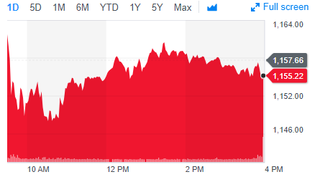
Stock Prices represent a time series
PRICE or Volume
TIME
BUT they are very hard to forecast due to external forces such as macro economic, international politics, sector/competitor actions, weather etc. From a forecasting perspective stock prices are often considered a “random walk” meaning traditional econometric forecasting techniques do not apply.

Slide 17
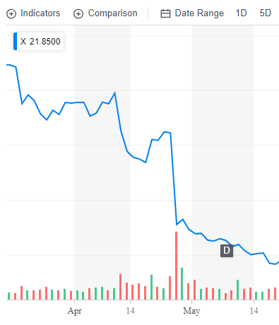
What happened to US Steel?
Daily Chart
4/25/17 Close : $31
4/26/17 Close: $22
4/26/17 Volume spike

Slide 18
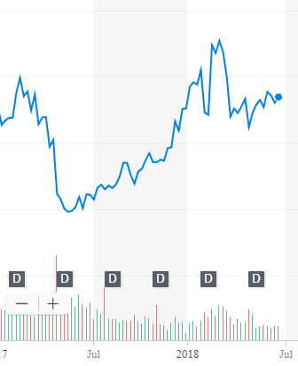
What other forces can impact US Steel?
Weekly Chart
After the disappointing quarter (self-inflicted) the stock rose dramatically. Why?
5/15/17: ~$20
2/26/18: ~$45

Slide 19
What other forces can impact US Steel?
Weekly Chart
After rhetoric of a trade war (international politics) with steel tariffs on their foreign competitors the price retreated and is now in a range. Why?
4/25/17: $31
4/26/17: $22
2/26/18: ~$45
4/16/18: ~$36
6/16/18 ~$36

Slide 20
What other forces can impact US Steel?
Weekly Chart
The trade war shifted towards talk about auto tariffs, coupled with high auto inventory.
4/25/17: $31
4/26/17: $22
2/26/18: ~$45
4/16/18: ~$36
6/16/18 ~$36

Slide 21
So forecasting (pattern recognition) methods won’t work.
Weekly Chart
Some stock movements are self-inflicted (quarterly miss), others political (tariffs) while others are based on out of sector (automotive) performance.

Slide 22
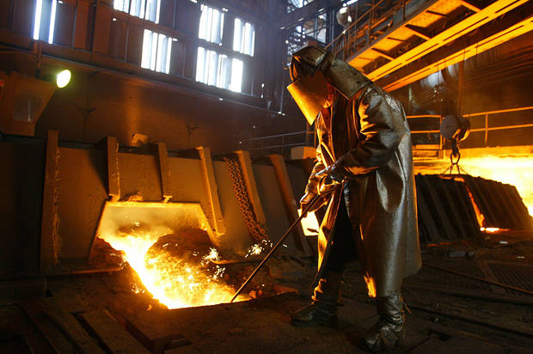


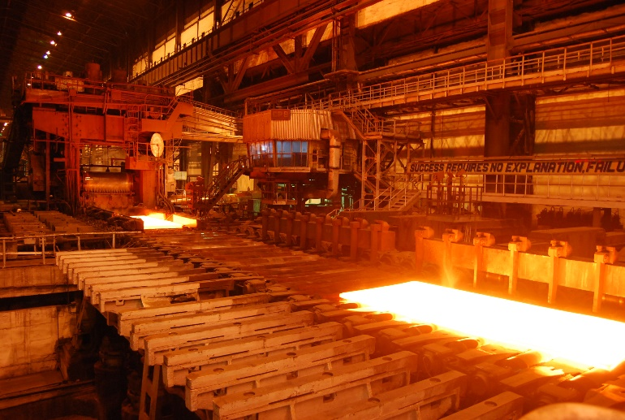
Meanwhile, US Steel was... producing steel.
Coincidentally, a belief investor would not have bought or sold but fundamental, technical and HFT would have been in and out at different times.

Slide 23
Let’s Practice! Open 1_TTR_A.R
Learning Objective:
Get real stock data
Subset an xts object
Plot the data in a dynamic plot

Slide 24
Agenda
Start | End | Item
 |  | Securities Summary
 |  | Securities Technical Trading Indicator- SMA
 |  | Securities Technical Trading Indicator- MACD
 |  | Securities Technical Trading Indicator- RSI
 |  | Financial Risk Modeling
 |  | Non-Traditional Markets

Slide 25
Example Technical Indicators
library(TTR)
SMA() #simple moving average
MACD() #moving avg convergence/divergence
RSI() #Relative Strength Index
For expediency we will cover 3 indicators but there are many more and you could even develop your own.

Slide 26
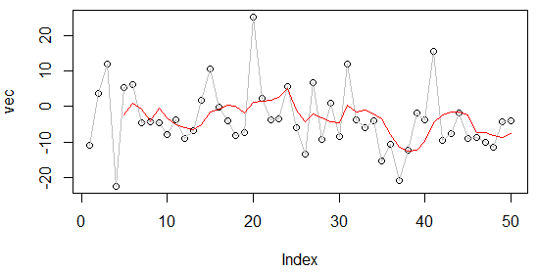
What is a moving average?
A smoothing technique reducing noise in a data series. Takes the average over “n” number of periods.
set.seed(1234)
vec <-rnorm(50,1,10)
plot(vec)
lines(vec, col='grey')
lines(SMA(vec, n=5), col='red')
vec[1:15]
[1,] -11.070657
[2,] 3.774292
[3,] 11.844412
[4,] -22.456977
[5,] 5.291247
[6,] 6.060559
[7,] -4.747400
[8,] -4.466319
[9,] -4.644520
[10,] -7.900378
[11,] -3.771927
[12,] -8.983864
[13,] -6.762539
[14,] 1.644588
[15,] 10.594941

Slide 27
What is a moving average?
A smoothing technique reducing noise in a data series. Takes the average over “n” number of periods.
vec[1:15]
[1,] -11.070657
[2,] 3.774292
[3,] 11.844412
[4,] -22.456977
[5,] 5.291247
[6,] 6.060559
[7,] -4.747400
[8,] -4.466319
[9,] -4.644520
[10,] -7.900378
[11,] -3.771927
[12,] -8.983864
[13,] -6.762539
[14,] 1.644588
[15,] 10.594941

Slide 28

What is a moving average?
A smoothing technique reducing noise in a data series. Takes the average over “n” number of periods.
vec[1:15]
[1,] -11.070657
[2,] 3.774292
[3,] 11.844412
[4,] -22.456977
[5,] 5.291247
[6,] 6.060559
[7,] -4.747400
[8,] -4.466319
[9,] -4.644520
[10,] -7.900378
[11,] -3.771927
[12,] -8.983864
[13,] -6.762539
[14,] 1.644588
[15,] 10.594941

Slide 29

What is a moving average?
A smoothing technique reducing noise in a data series. Takes the average over “n” number of periods.
vec[1:15]
TTR::SMA(vec[1:15], n=5)
[1,] -11.070657
[2,] 3.774292
[3,] 11.844412
[4,] -22.456977
[5,] 5.291247
[6,] 6.060559
[7,] -4.747400
[8,] -4.466319
[9,] -4.644520
[10,] -7.900378
[11,] -3.771927
[12,] -8.983864
[13,] -6.762539
[14,] 1.644588
[15,] 10.594941
[1,] NA
[2,] NA
[3,] NA
[4,] NA
[5,] -2.5235367
[6,] 0.9027066
[7,] -0.8016318
[8,] -4.0637779
[9,] -0.5012865
[10,] -3.1396115
[11,] -5.1061087
[12,] -5.9534017
[13,] -6.4126457
[14,] -5.1548241
[15,] -1.4557603

Slide 30
Open 1_TTR_B.R
Learning Objective:
Get real stock data
Subset an xts object
Create three simple moving averages and plot to see the smoothing effect

Slide 31
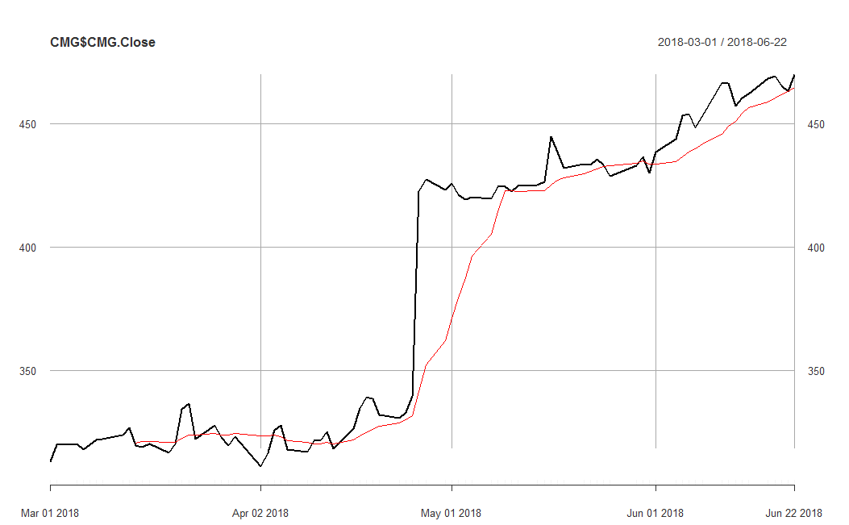
So how does SMA become an Indicator?
An investor can “backtest” the strategy to find an acceptable “n”. Once the best “n” is found, the SMA line represents points to buy and sell as the price crosses over.

Slide 32

So how does SMA become an Indicator?
Red Card! We need to lag the trading rule to ensure the signal is realistic. Calculations are not real time, but at close so you need to adjust the results to emulate a real scenario.

Slide 33
Open 1_TTR_C_v2.R
Learning Objective:
Get real stock data
Subset an xts object
Calculate SMA
Create a trading indicator (rule)
Lag the Rule
Back-test the lagged rule to see cumulative returns
Switch a single character in the rule and back-test again to see the impact

Slide 34
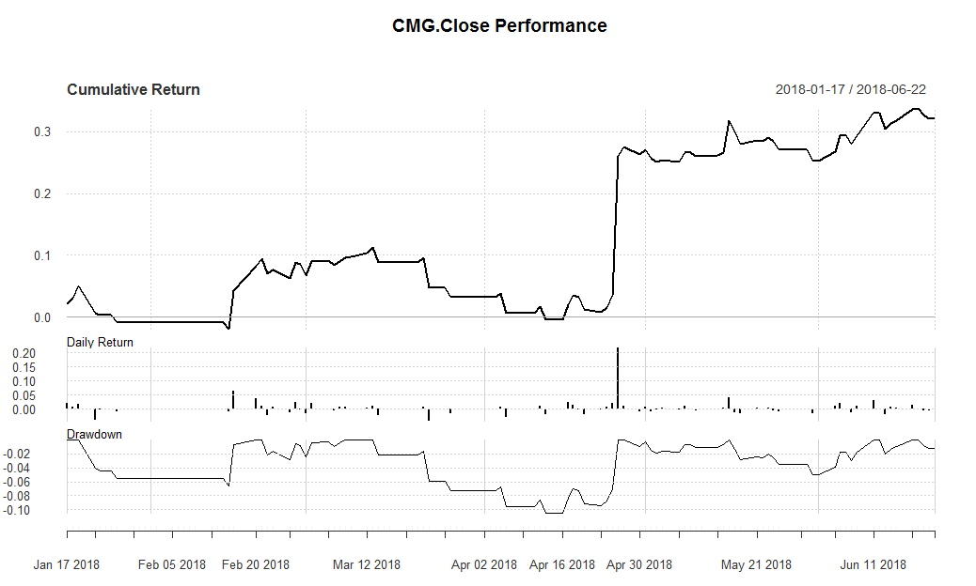
SMA as an Indicator for CMG
Total Cumulative Return using the rule.
Day to Day Return
Important if rule is sub one day periodicity.
Peak to trough % change, used to understand volatility.
Due to the price spike, ~20% of the total cumulative ~30% came in a single session. One could still argue the rule reduced risk because there were days without any capital exposure and the rule provided returns beyond the 1 day surge.

Slide 35
Agenda
Start | End | Item
 |  | Securities Summary
 |  | Securities Technical Trading Indicator- SMA
 |  | Securities Technical Trading Indicator- MACD
 |  | Securities Technical Trading Indicator- RSI
 |  | Financial Risk Modeling
 |  | Non-Traditional Markets

Slide 36
Moving Average Convergence Divergence
By measuring the moving average of two moving averages with different time frames, an investor hopes to capture when momentum is building or receding.
Instead of “n”:
nFast(12) – the smaller window to measure (12 periods)
nSlow(26)- the longer window to measure (26 periods)
nSig(9)- the number of periods used to measure the avg difference “signal”
Calculate the 12 (nFast) day & 26 (nSlow) day moving averages.
Calculate the difference between average from #1
Calculate the 9 day Moving Avg (nSig) of #2
When MACD is positive, the price is accelerating, positive momentum/money is coming to the equity which represents a buying opportunity. Converse is true.

Slide 37
One small addition difference.
MACD uses exponential moving averages (EMA).
SMA
EMA
Each value in the “n” window has an equal weight.
Each value in the “n” window has an different weight. The weights decrease the farther back in time e.g. recent data is more relevant.
For example:
vec <-c(1,2,3,4,5)
mean(vec)
#sum(vec)/5 i.e. 15/5
3
Advantage:
Faster to recognize a buy/sell signal.
Disadvantage:
More false signals, more sensitivity

Slide 38
Open 1_TTR_D.R
Learning Objective:
Get real stock data
Subset an xts object
Calculate MACD
Plot a dynamic graph of the closing & MACD indicator
Visually inspect the results of buy/sell actions
Calculate cumulative return for the indicator

Slide 39
Agenda
Start | End | Item
 |  | Securities Summary
 |  | Securities Technical Trading Indicator- SMA
 |  | Securities Technical Trading Indicator- MACD
 |  | Securities Technical Trading Indicator- RSI
 |  | Financial Risk Modeling
 |  | Non-Traditional Markets

Slide 40
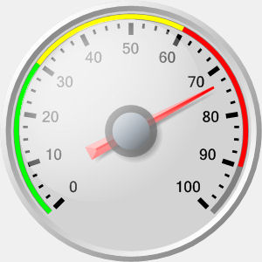
Relative Strength Index (RSI)
Momentum Oscillator
Index between 0-100
Compares average gains and losses in 14 day periods (“n”)
Usually interpreted as an overbought/oversold (over 70 / below 30)
* Usually uses EMA but we will do SMA.

Slide 41
Creates a control chart.
70
RSI
30
TIME
When the RSI dips below a threshold (30) the stock is considered “oversold” meaning the market has overreacted to something and RSI may indicate a buying opportunity. RSI greater than 70 indicates the market is over buying the stock so it may be good to exit your position.

Slide 42
Calculating the RSI
RSI = 100 - (100 / 1+RS)
Where RS:
RS = Avg Gain / Avg Loss
Avg Gain = For “up” days, total number of points up / number of “up” days
Avg Loss = For “down” days, total number of points down/ number of “down” days

Slide 43
Open 1_TTR_F.R
Learning Objective:
Get real stock data
Calculate RSI
Plot a dynamic graph of the closing & RSI indicator
Visually inspect the results of buy/sell actions
Calculate cumulative return for RSI and MACD together

